Slide 1






Ten Years of Making the Adder Count
Clark Bradbury Charitable Trust
John Baker & Emma Gardner

Slide 2

Adder Status
COOKE, A.S. & ARNOLD, H.R., 1982. National changes in the status of the commoner British amphibians and reptiles before 1974, British Journal of Herpetology 6, 206-207.
COOKE, A.S. & SCORGIE, H.R.A., 1983. The Status of the commoner amphibians and reptiles in Britain. Focus on Nature Conservation, No. 3. NCC.
HILTON-BROWN, D. & OLDHAM, R.S., 1991. The status of the widespread amphibians and reptiles in Britain, 1990, and changes during the 1980s. Focus on Nature Conservation, No. 131. NCC.
GLEED-OWEN, C. & LANGHAM., S., 2012. The Adder Status Project – a conservation condition assessment of the adder (Vipera berus) in England, with recommendations for future monitoring and conservation policy. ARC.
NARRS.
Notes:
Make the Adder Count was prompted by concern about adder status and in particular, following on from an English Nature Research Report (546).

Slide 3
Prompts for Make the Adder Count
Common themes
Declining status – and increasing concerns.
Expert opinion – or lack of quantitative data.
An observation
There was a small core of ‘adder-watchers’.
Notes:
Make the Adder Count was prompted by concern about adder status and in particular, following on from an English Nature Research Report.

Slide 4
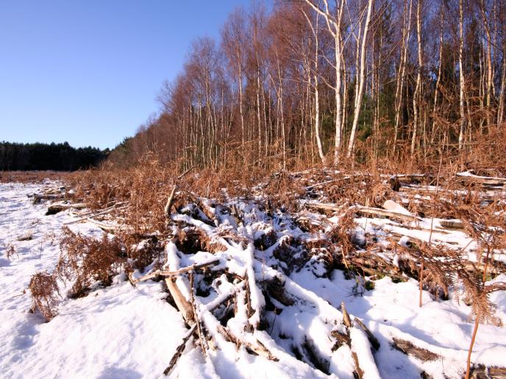
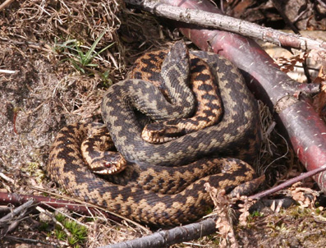
Focus on hibernation sites
Repeatedly used
Populations often concentrated
Present for many months
Snakes (males at least) relatively easy to survey
Notes:
A focus on hibernation sites had dual benefits. The hibernations site themselves are critical to adder ecology/management. Populations can be concentrated in very small areas – which can be used year after year – for much of their time. Locations of hibernation sites should be considered by site management plans.

Slide 5
Make the Adder Count - Aims
Collect quantitative data
Standardise observations
Investigate potential of approach
Focus attention on (and locate) adder hibernacula
Raise profile of adder
Notes:
Surveyors were asked to simply to count the numbers of adults adders seen lying out during spring emergence. Up to six counts per site should be make and the highest count was termed ‘peak count’.

Slide 6
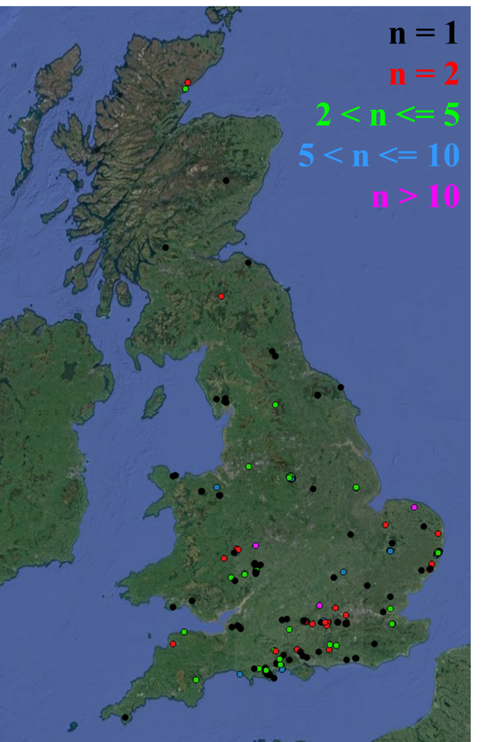
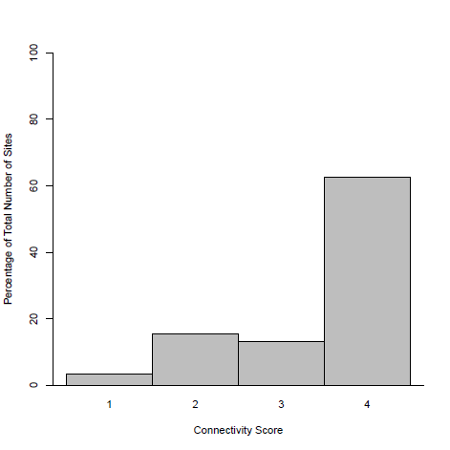
Survey Sites
260 sites
181 surveyors
Wide variation in length of timeseries per site
Connected by continuous habitat to many other populations
Completely isolated
Percentage of Total No. of Sites
Connectivity Score
Notes:
260 sites, most of which are well connected to other adder populations, suggesting connectivity is potentially important for adders. Map shows survey site locations colour-coded by number of years of survey data – wide variation in length of timeseries from each site.

Slide 7
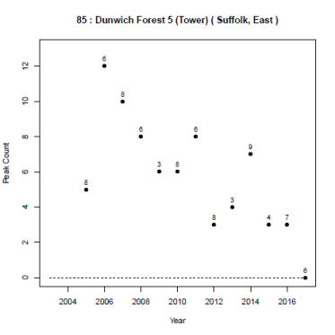
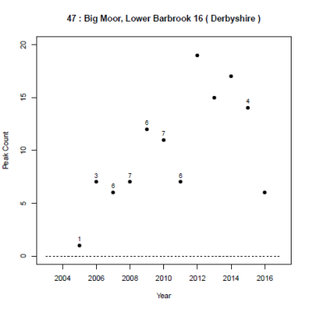
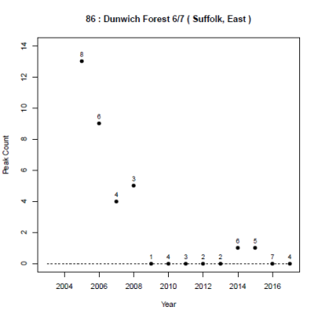
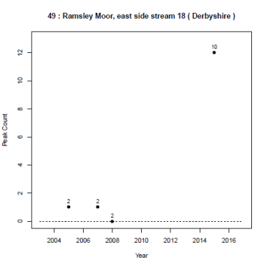
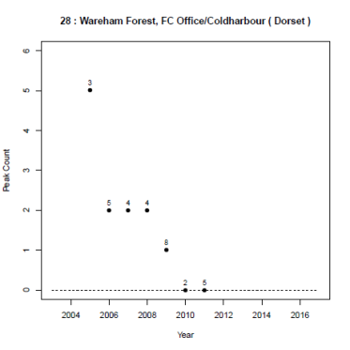
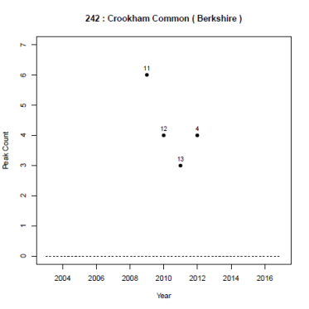
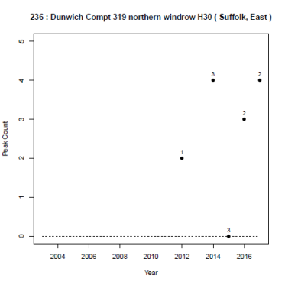
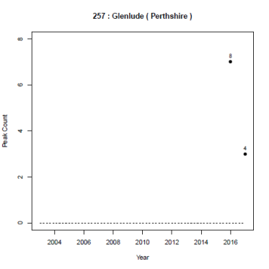
Timeseries
Notes:
Example timeseries showing varying population trends and varying temporal coverage.

Slide 8
Timeseries
Aim: derive average population trends across sites
Notes:
Our primary aim was to derive population trends from this dataset. If we combine the data from multiple sites, on average, do we find that adder numbers are increasing, decreasing or remaining stable across those sites?

Slide 9
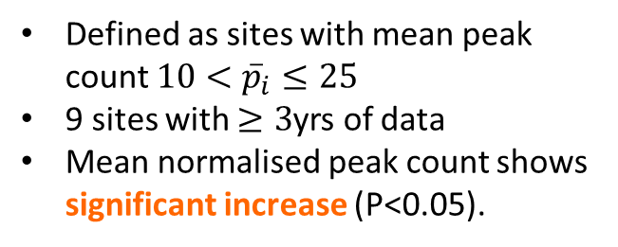
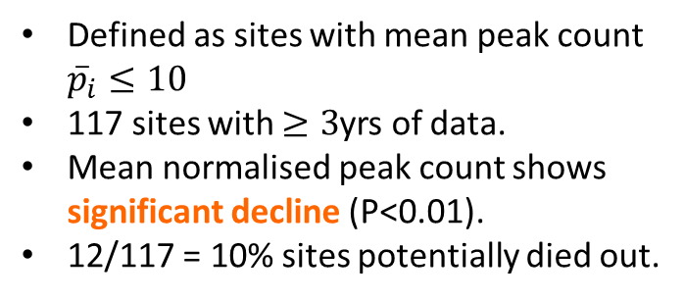
Population Trends
Small Populations
Large Populations
Defined as sites with mean peak count ${\overline{p}}_{i}≤10$
117 sites with $≥3$yrs of data.
Mean normalised peak count shows significant decline (P<0.01).
12/117 = 10% sites potentially died out.
Defined as sites with mean peak count $10<{\overline{p}}_{i}≤25$
9 sites with $≥3$yrs of data
Mean normalised peak count shows significant increase (P<0.05).
Notes:
First split the sites into those with small adder populations (mean peak count <=10) and those with large populations (10< mean peak count <=25). Analysed these two groups separately.

Slide 10
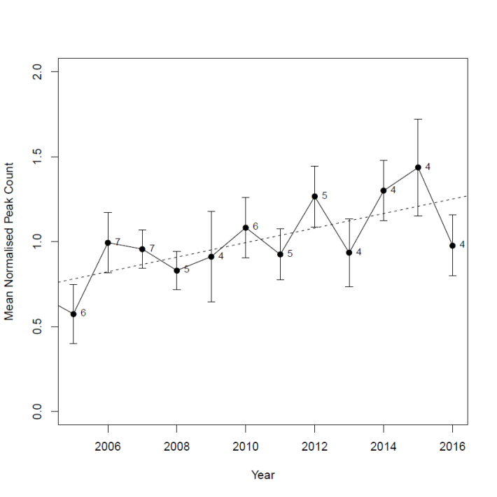

Population Trends
Small Populations
Large Populations
Defined as sites with mean peak count ${\overline{p}}_{i}≤10$
117 sites with $≥3$yrs of data.
Mean normalised peak count shows significant decline (P<0.01).
12/117 = 10% sites potentially died out.
Defined as sites with mean peak count $10<{\overline{p}}_{i}≤25$
9 sites with $≥3$yrs of data
Mean normalised peak count shows significant increase (P<0.05).
$${\overline{P}}_{norm}\left(t\right)=(0.04±0.02)t−(90±30)$$
Notes:
Large population sites: their average population trend shows a significant increase over time.

Slide 11
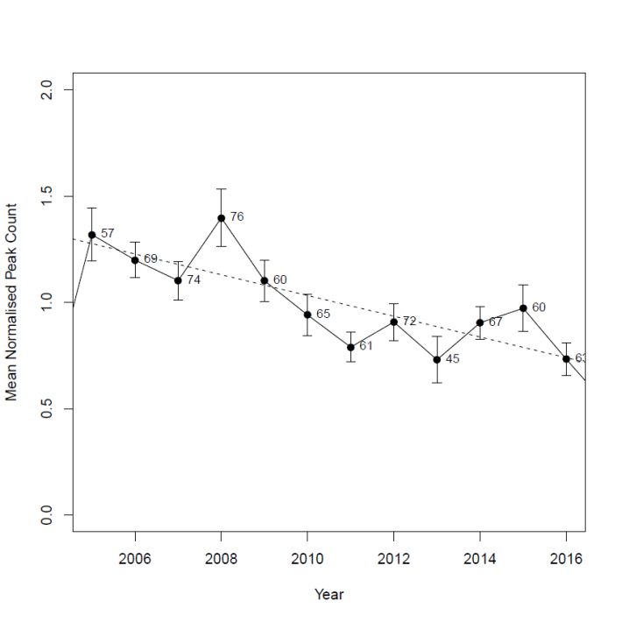
Population Trends
Small Populations
Large Populations
Defined as sites with mean peak count ${\overline{p}}_{i}≤10$
117 sites with $≥3$yrs of data.
Mean normalised peak count shows significant decline (P<0.01).
12/117 = 10% sites potentially died out.
Defined as sites with mean peak count $10<{\overline{p}}_{i}≤25$
9 sites with $≥3$yrs of data
Mean normalised peak count shows significant increase (P<0.05).
$${\overline{P}}_{norm}\left(t\right)=−(0.05±0.01)t+(100±20)$$
$${\overline{P}}_{norm}\left(t\right)=(0.04±0.02)t−(90±30)$$
Notes:
Small population sites: Show a significant decline over time. A contributing factor is that just over 10% of these sites have potentially lost their adder populations since MTAC started, by which I mean, for the last two or more years those sites were surveyed, no adders were recorded. Obviously this is not good!

Slide 12
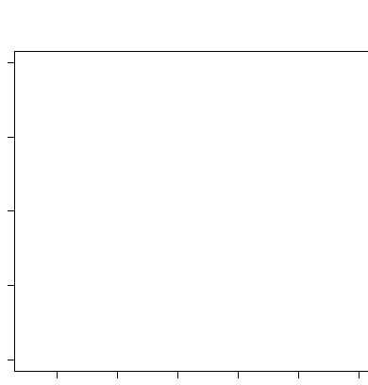
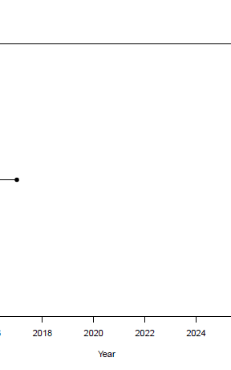
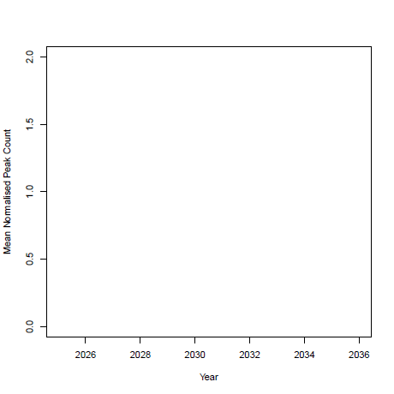

Population Trends
Small Populations
Large Populations
Defined as sites with mean peak count ${\overline{p}}_{i}≤10$
117 sites with $≥3$yrs of data.
Mean normalised peak count shows significant decline (P<0.01).
12/117 = 10% sites potentially died out.
Defined as sites with mean peak count $10<{\overline{p}}_{i}≤25$
9 sites with $≥3$yrs of data
Mean normalised peak count shows significant increase (P<0.05).
$${\overline{P}}_{norm}\left(t\right)=−(0.05±0.01)t+(100±20)$$
$${\overline{P}}_{norm}\left(t\right)=−(0.05±0.01)t+(100±20)$$
Notes:
We can be pessimistic and ask, if this trend continues, when would an average small population site completely lose its adders? If we extrapolate the trend line, we get a lower limit estimate on this happening within just 13 years. It’s a lower limit because we’re assuming that, when the surveyors recorded no adders, there genuinely were no adders…and we all know detectability isn’t perfect like that!

Slide 13
Population Trends
Small Populations
Large Populations
Defined as sites with mean peak count ${\overline{p}}_{i}≤10$
117 sites with $≥3$yrs of data.
Mean normalised peak count shows significant decline (P<0.01).
12/117 = 10% sites potentially died out.
Defined as sites with mean peak count $10<{\overline{p}}_{i}≤25$
9 sites with $≥3$yrs of data
Mean normalised peak count shows significant increase (P<0.05).
$${\overline{P}}_{norm}\left(t\right)=−(0.05±0.01)t+(100±20)$$
$${\overline{P}}_{norm}\left(t\right)=(0.04±0.02)t−(90±30)$$
Notes:
So it’s not looking good for small population sites. But we could ask, how much does this really matter, given that the large population sites are doing ok?

Slide 14
Population Trends
Small Populations
Large Populations
Defined as sites with mean peak count ${\overline{p}}_{i}≤10$
117 sites with $≥3$yrs of data.
Mean normalised peak count shows significant decline (P<0.01).
12/117 = 10% sites potentially died out.
Defined as sites with mean peak count $10<{\overline{p}}_{i}≤25$
9 sites with $≥3$yrs of data
Mean normalised peak count shows significant increase (P<0.05).
$${\overline{P}}_{norm}\left(t\right)=−(0.05±0.01)t+(100±20)$$
$${\overline{P}}_{norm}\left(t\right)=(0.04±0.02)t−(90±30)$$
Notes:
If you compare the actual numbers, you see that more than 90% of our sites fall into this small population category. If this is representative of the country as a whole, this suggests adders are likely to become restricted to a few large population sites, which makes them very vulnerable. At this point we should ask, why are these declines happening?

Slide 15
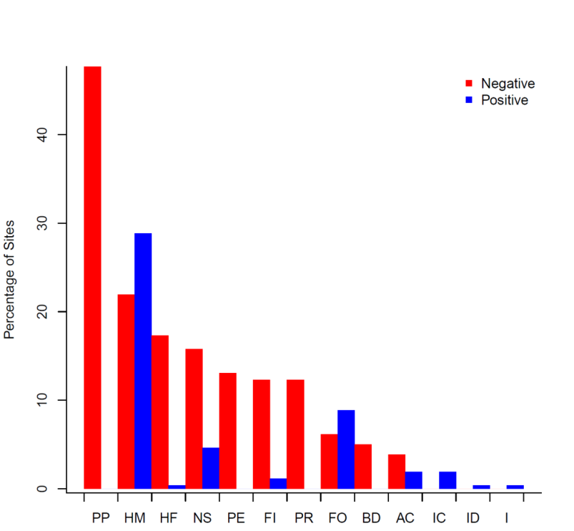
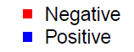


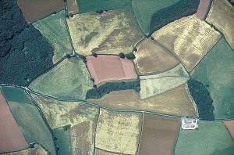
Key Factors Affecting Adder Populations
PP = Public Pressure through Disturbance
HM = Habitat Management
HF = Habitat Fragmentation
NS = Neglect/Succession
PE = Persecution
FI = Fire
PR = Predation
FO = Forestry Operations
BD = Building Development
AC = Agricultural Changes
IC = Introduction for Conservation
ID = Introduction for Development Mitigation
I = Introduction (not specified)
Percentage of Sites
Notes:
Surveyors asked to report the positive and negative factors affecting their sites. Top three negative factors reported: public pressure through disturbance, habitat management and habitat fragmentation. Quite shockingly, where habitat management occurs, more than 40% of the time it is potentially having a negative effect on the adders. Not what you want from habitat management!

Slide 16
Negative Factors (%)
 | 1983 | 1991 | 2004 | 2017
 | C&S | HB&O | ENRR | Current
PP | 14 | 19 | 25 | 48
HM | 5* | N/A | 12 | 22
HF | N/A | N/A | N/A | 17
NS | N/A | 6 | 14 | 16
PE | 19 | 6 | 17 | 13
FI | 16 | 6 | 12 | 12
PR | 0 | N/A | 9 | 12
FO | 14 | 19 | 10 | 6
BD | 8 | 6 | 10 | 5
AC | 19 | 16 | 4 | 4
Notes:
We can compare the negative factors reported to MTAC, with those of previous studies, to compare how perceptions of negative factors have changed over time. I have highlighted the top three negative factors for each study. Reasons for change could reflect changes in understanding (for instance, HF is not even given as a category in these earlier studies), or reflect genuine changes in significance of factors, or most likely a bit of both. Notice the increasing reporting of public pressure - now way the most frequently reported. It suggests this is an area worth looking at more closely.

Slide 17
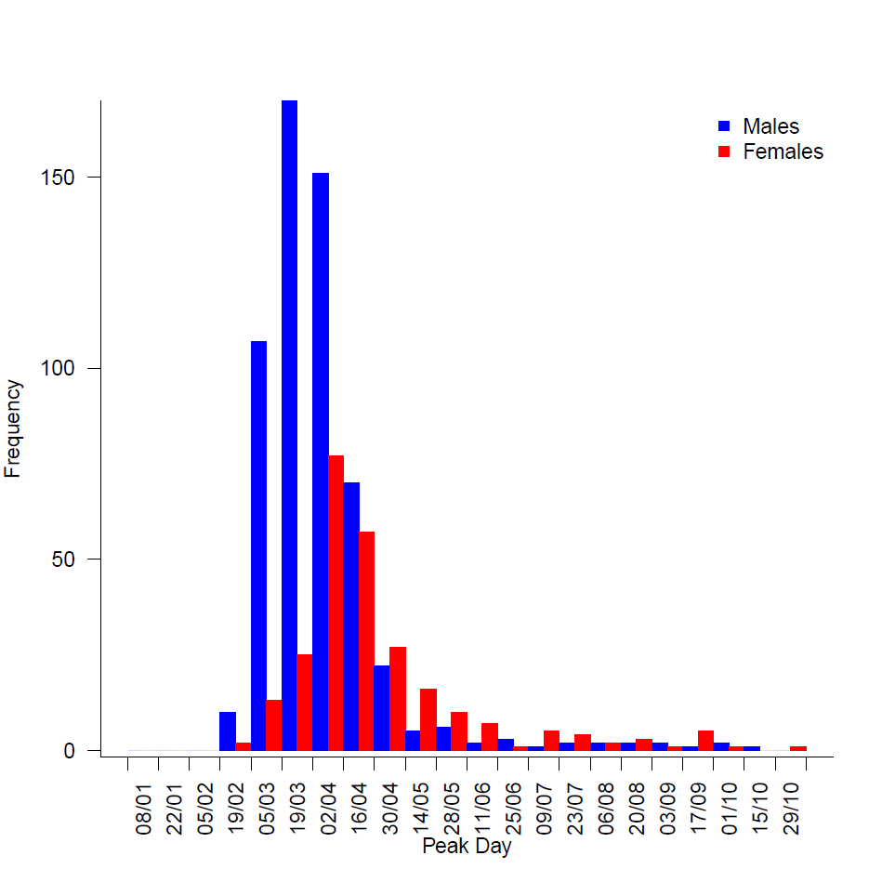
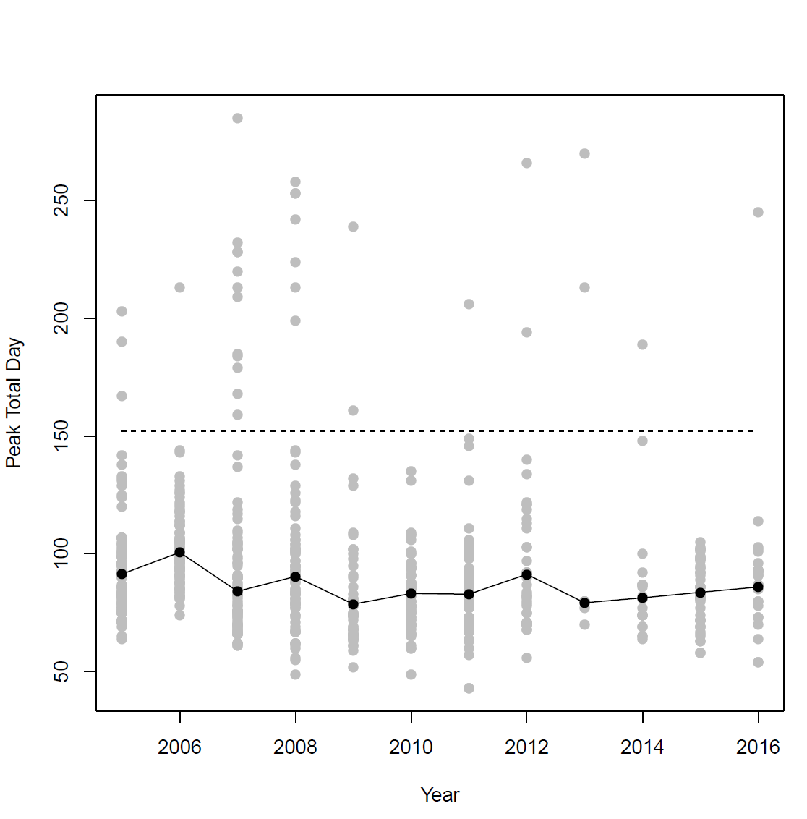
Beyond Population Trends: Behaviour & Phenology
Investigate differences in emergence timing.
Males peak fortnight earlier than females
Inter-annual variation in date of peak count:
Response to weather?
Potential to adapt to climate change
Notes:
So far, our main focus has been on identifying population trends. But there are other things we can do with this dataset. Surveyors record the date of their counts, so can also use this information to investigate differences in timing of peak counts, and so quantifying aspects of adder behaviour. For instance, surveyors are asked (if possible) to record male and female adders separately. If you compare the date the male count peaks with the date the female count peaks, can see males are getting out there a fortnight earlier than the females. Also see variation in date of peak count between years. Perhaps this is a response to varying spring temperatures? Such sensitivities to temperature could tell us how well adders may adapt to climate change, or not. These are aspects of the dataset we are just starting to look into.

Slide 18
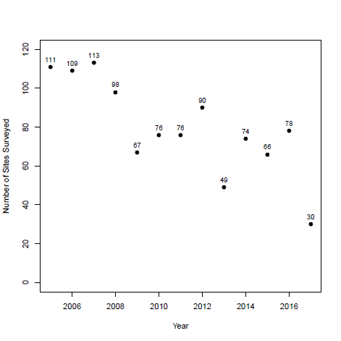
MTAC Going Forward
Huge THANK YOU to all surveyors who have contributed data!
Please keep surveying and sending in results
Reporting zero counts is really important
Expand geographical range of survey
Number of Sites Surveyed
Year
Notes:
MTAC has been running for 12 years now. Where do we go from here? Firstly should say a huge thank you to all the surveyors who have contributed data. Couldn’t do it without you! Please keep surveying and sending in your results. No. of sites returning data has been steadily declining over time. We are getting some really important population trends out of this data, so it’s really important we keep up this monitoring, so we can push for better protection for adders and monitor the effectiveness of conservation interventions.

Slide 19
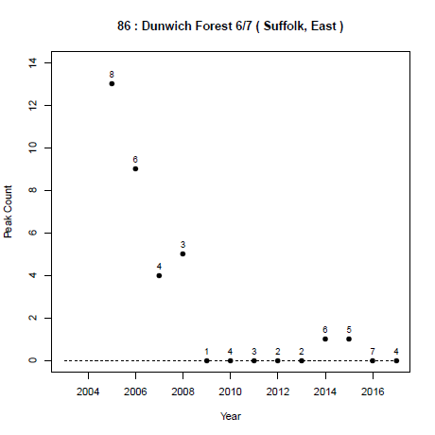
MTAC Going Forward
Huge THANK YOU to all surveyors who have contributed data!
Please keep surveying and sending in results
Reporting zero counts is really important
Expand geographical range of survey
Site 86
Peak Count
Year
Notes:
Reporting zero counts is really important. If you’ve started getting zero counts at your site, please still report them because that’s really important information. If we don’t have these absence records, where there previously were adders, then we will overestimate how well adders are doing.

Slide 20
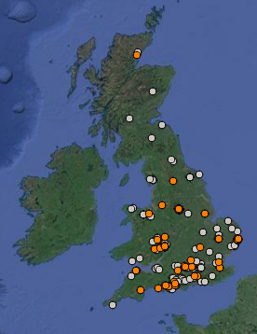
MTAC Going Forward
Huge THANK YOU to all surveyors who have contributed data!
Please keep surveying and sending in results
Reporting zero counts is really important
Expand geographical range of survey
Notes:
Finally, it would be great if we can expand the geographical range of the survey. Grey points show distribution of all sites and I’ve coloured orange those sites that currently have enough data to be included in the population trend analysis, ie. these sites have 3 or more years of data. Can see our population trends currently biased towards southern sites. Ideally want to improve coverage, by adding new sites and by resurveying some of these existing sites that don’t yet have enough data for analysis.

Slide 21
Conclusions
MTAC data confirm expert opinion (ENRR 546):
Small populations more prone to declines
Most populations are small
Perceived threats:
Public pressure (disturbance) most common threat
Habitat management largest positive factor but negative impacts persist.
Going forward:
Shown methodology can yield useful data
Provides database of hibernacula locations (essential information for habitat management)
Improve geographical coverage
www.recordpool.org.uk/make-the-adder-count

Slide 22
Thank you to all MTAC’s surveyors!
Nigel Agar, Alan Anderson, Tommy Armstrong, Steve Babbs, John Baker, Axel Barlow, Marcus Barlow, Alan Barrett, Richard Bazley, Frank Bell, Paul Benson, Richard Birch, Nick Blacker, Bill Blake, Stephen Block, Frank Bowles, James Boyd, Mark Bradfield, Scot Bradley, David Bradley, Ian Bradley, Lee Brady, Eleanor Bremner, Giles Brockman, Mick Brummage, Nick Burfield, John Butter, John Campbell, Anthony Cannon, Lucy Cash, Kathy & John, Karl Charters, Don Clark, Phil Conopo, Mark Conway, Rachel Cook, Arnold Cooke, Jon Cranfield, Stuart Croft, Sue Crookes, Simon Crump, Nick Davis, Phil Davison, Bernard Dawson, Selwyn Dennis, John Dickson, Jack Douglas, Philip Drury, Laurent Duvergi, Glyn Eamus, Graham Ella, Barry Embling, Jane Evans, Jonathan Fane, Clive Flindall, Laurie Forsyth, Jim Foster, John Fraser, Alf Gapper, Hadyn Garlic, Dave Garner, Chris Gleed-Owen, Bernard Goillon, Ken Green, Louise Gregory, John Grundy, Jim Gunn, Peter Hallet, Nigel Hand, Stewart Hardie, Martin Hartup, Rebecca Haworth, Gordon Haycock, Matthew Hayward, Pete Hill, Dan Hoare, Kerry Holmes, Alan Hyde, Colin Jacobs, Bob Johnson, Arthur Jollands, Glyn Jones, Angie Julian, DJ Law, Adam Long, Dave Mackay, Paul Malcolm, Dave Mallon, Lee Malpass, Helen Markwell, Simon Mason, Rennie Mason, Gareth Matthes, Lindsay McCrae, Alistair McGregor, Kathy Meakin, Helen Metcalfe, Adrian Middleton, George Millins, Simon Mole, Chris Monk, Simon Munnery, Tony Murphy, Sarah Murray, Nicola Murray, Dave and Marion Nesbitt, John Newton, David Norfolk, Dave Odell, John Osbourne, Dave Page, Kev Palmer, Lisa Parker, Tom Parkin, Susie Pearson, Lizzy Peat, Graham Pettingale, Tony Phelps, Marcus and Susan Philips, Adrian Podmore, Anne Porter, Gary Powell, Karen Purvis, Sue Raven, Mark Rawlins, Rob Raynor, David Redgrove, Brian Redman, Jo Richards, David Rous, Mark Ruff, Johnny Scott, Peter Scott, Jon Seller, Ian Shale, Sylvia Sheldon, Dave Showler, Alf Simpson, Christopher Slack, Linda Smith, Rob Smith, Paul Smith, Damian Smith, Ian Spalding, Jenny Spencer, Paul Stevens, Jim Stewart, Lisa Stitt, Peter Stronach, Kevin Sunderland, Des Sussex, Duncan Sweeting, Mike Swindells, Dave Tamarind, Stuart Taylor, Michael Taylor, Nigel Taylor, Dave Thomas, Mike Thompson, Ian Tomlinson, Simon Townson, Mandy Tulloch, Chris Turner, Dougal Urquhart, Hetty Wakeford, Natalie Walker, Graham Walters, Tony Walton, Robin Ward, David Wareham, Mark Warn, Dan Watson, Andy Welling, Brett Westwood, Liz Wild, Paul Wilkinson, Joanne Wilkinson, Jonathan Willet, Andrew Woodhouse, Wolfgang Wüster.

Slide 23
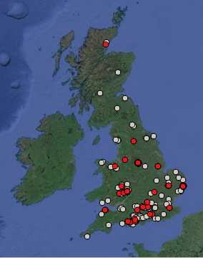

Site Distributions
Small Populations
Large Populations

Slide 24
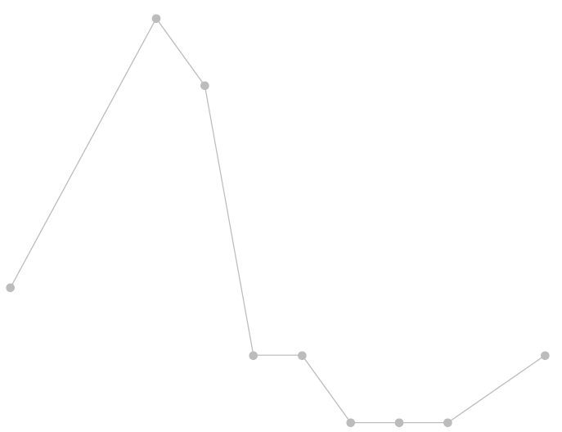
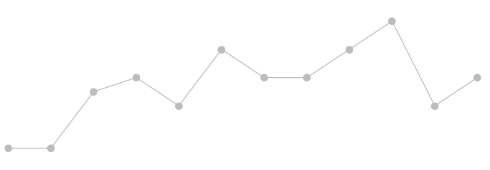
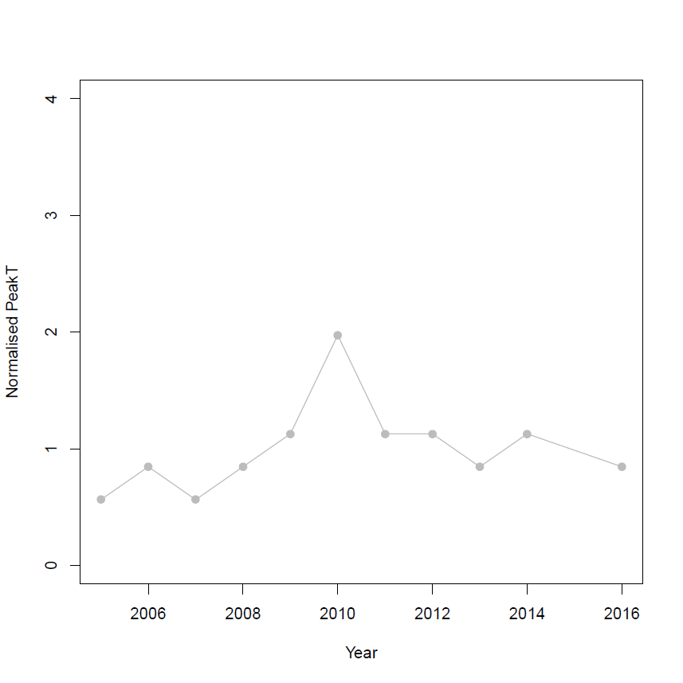
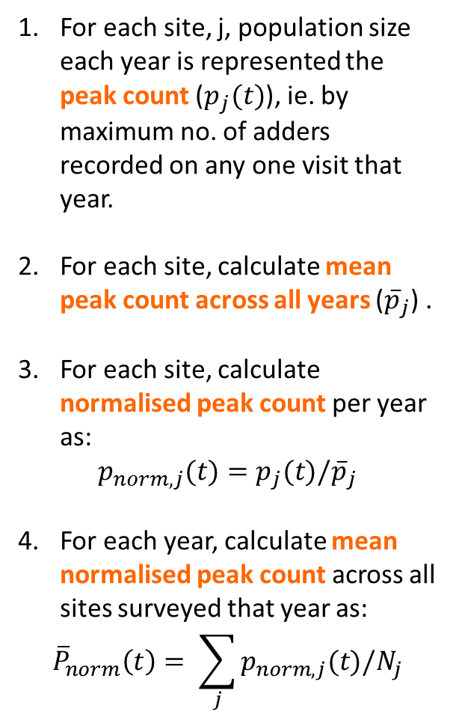
Population Trends
For each site, j, population size each year is represented the peak count ($p_{j}(t)$), ie. by maximum no. of adders recorded on any one visit that year.
For each site, calculate mean peak count across all years (${\overline{p}}_{j}$) .
For each site, calculate normalised peak count per year as:
$$p_{norm,j}(t)=p_{j}(t)/{\overline{p}}_{j}$$
For each year, calculate mean normalised peak count across all sites surveyed that year as:
$${\overline{P}}_{norm}\left(t\right)= \sum_{j}{p_{norm,j}(t)/N_{j}}$$
Peak Count
Time (years)
Normalised Peak Count
Time (years)
Notes:
Slide showing how the average population trends are calculated.

